Slide 1

Lecture #2

Slide 2
Computer System Structure
Computer system can be divided into four components:
Hardware – provides basic computing resources
CPU, memory, I/O devices
Operating system
Controls and coordinates use of hardware among various applications and users
Application programs – define the ways in which the system resources are used to solve the computing problems of the users
Word processors, compilers, web browsers, database systems, video games
Users
People, machines, other computers

Slide 3

Four Components of a Computer System

Slide 4
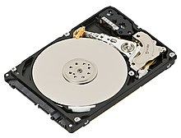
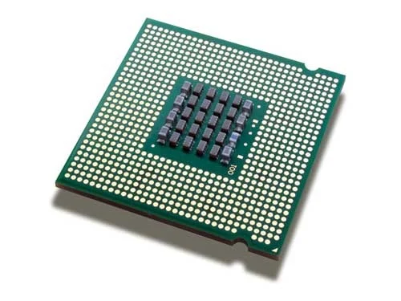
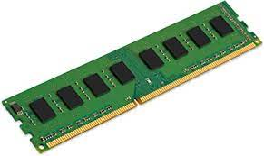
Hard Disk
RAM
Processor

Slide 5
Basic components of a CPU
Program Counter (PC)
Holds the memory address of the next instruction
Instruction Register (IR)
holds the instruction currently being executed
General Registers (Reg. 1..n)
hold variables and temporary results
Arithmetic and Logic Unit (ALU)
performs arithmetic functions and logic operations

Slide 6
Stack Pointer (SP)
holds memory address of a stack with a frame for each active procedure’s parameters & local variables
Memory Address Register (MAR)
contains address of memory to be loaded from/stored to
Memory Data Register (MDR)
contains memory data loaded or to be stored

Slide 7
Application programs
Application programs (or apps) are software designed for users to perform specific tasks like writing, browsing, gaming, or editing, distinct from system software that runs the computer itself; common examples include
web browsers (Chrome, Firefox),
office suites (Microsoft Office, Google Docs), and
media players (Spotify, VLC).
These programs provide direct functionality for end-users, acting as tools to manage data, communicate, or entertain.

Slide 8
Two Views of Operating System
User's View
System View

Slide 9
Operating System: User View
The user view of the computer refers to the interface being used.
Such systems are designed for one user to utilize its resources, to maximize the work that the user is performing.
In these cases, the operating system is designed mostly for ease of use, with some attention paid to performance, and none paid to resource utilization.

Slide 10
Operating System: System View
Operating system can be viewed as a resource allocator also.
A computer system consists of many resources like - hardware and software - that must be managed efficiently.
The operating system acts as the manager of the resources, decides between conflicting requests, controls execution of programs etc.

Slide 11
What Operating Systems Do
Depends on the point of view
Users want convenience, ease of use and good performance
Don’t care about resource utilization
But shared computer such as mainframe or minicomputer must keep all users happy
Users of dedicate systems such as workstations have dedicated resources but frequently use shared resources from servers
Handheld computers are resource poor, optimized for usability and battery life
Some computers have little or no user interface, such as embedded computers in devices and automobiles

